Slide 1
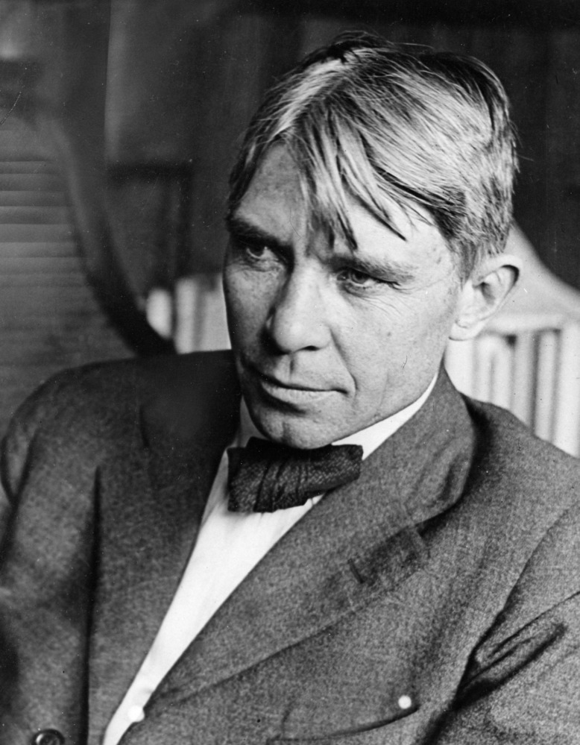
"Poet of the People“
Carl Sandburg provided a popular voice for the American people of the twentieth century and still speaks to us through his words, activism, music and the beauty and serenity of Carl Sandburg Home National Historic Site.
www.nps.gov/carl

Slide 2
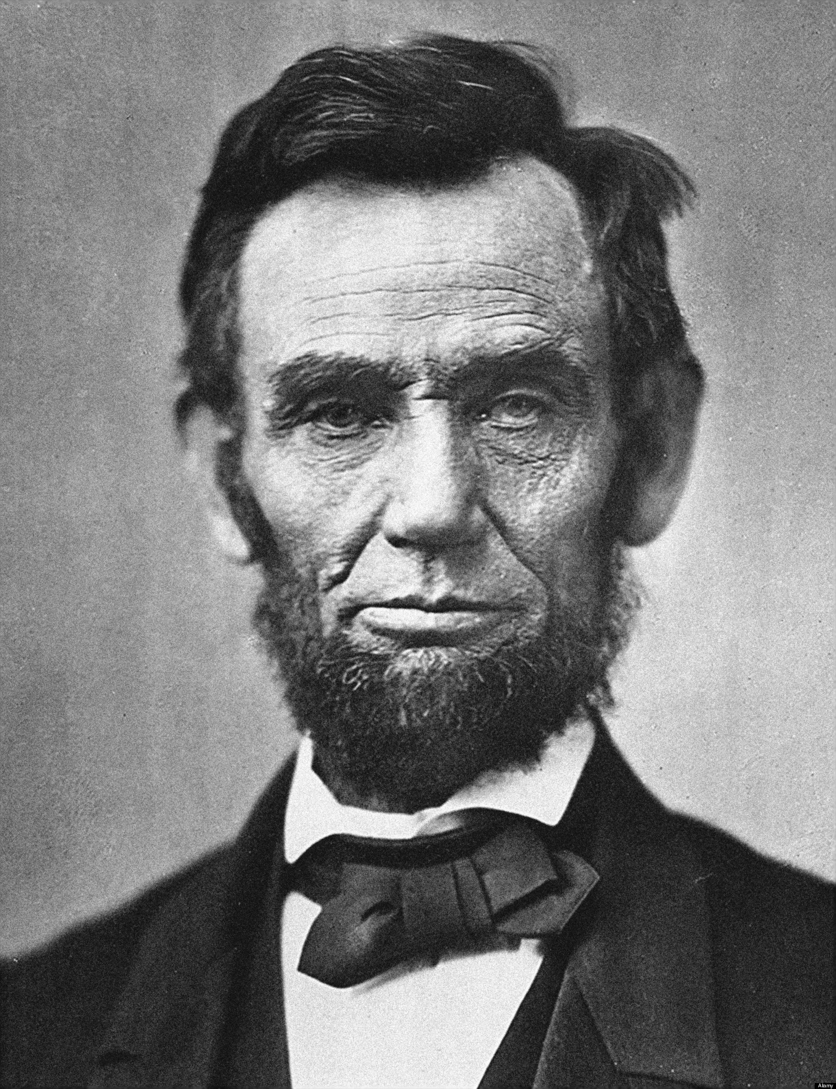
Carl Sandburg: Biographer of Lincoln Grades 3rd - 5th
Carl Sandburg was known as the Poet of the People. He loved writing so much that he wrote poetry, children's stories, news articles, and a biography about Abraham Lincoln, as well as an autobiography about himself.
Tasks:
Listen to Carl Sandburg read his tribute to Lincol
Answer questions about his writing.
Brainstorm about a famous person who inspires you.
4) Write an informational piece or biography of that person’s life.

Slide 3
Carl Sandburg: Biographer of Lincoln
A biographer is a person who writes about someone else’s life. As a young boy growing up in Galesburg, Illinois, Carl Sandburg often listened to stories of people who had known Abraham Lincoln. Sandburg often felt that he was lucky to grow up in such a rich Lincoln area and that perhaps he would write a biography of Abraham Lincoln for young people that would give American children an opportunity to learn about Lincoln as he did.
Click here https://www.youtube.com/watch?v=LiYzsrkYls8 to listen to Carl Sandburg read his tribute to Abraham Lincoln. Then read the section from his book “ Abe Lincoln Grows Up” on slide 4. On slide 5, answer questions about this part of the text.

Slide 4
Excerpt from Abe Lincoln Grows Up - The Sandburg Treasury pg. 398
“On the Knob Creek farm the child Abraham Lincoln learned to talk, to form the words with the tongue and the roof of the mouth and the force of the breath from lungs and throat. “Pappy” and “Mammy” the words of his people meaning father and mother, were among the first syllables. He learned what the word “name” meant; his name was Abraham, the same as Abraham in the Bible, the same as his grandfather Abraham. It was “Abe” for short; if his mother called in the dark, “Is that you, Abe?” he answered, “Yes, Mammy, it’s me.” The name of the family he belonged to was “Lincoln” or “Linkun,” though most people called it “Linkern” and it was sometimes spelled “Linkhorn.”
The family lived there on Knob Creek farm, from the time Abe was three or so till he was past seven years of age. Here he was told “Kaintucky” meant the state he was living in; Knob Creek farm, the Rock Spring farm where he was born, Hodgenville, Elizabethtown, Muldraugh’s Hill, these places he knew, the land he walked on, was all part of Kentucky.”

Slide 5
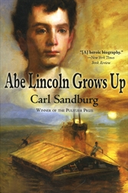
After reading the section of the biography, answer the questions below using supporting details from the text. Remember to write using complete sentences!
What do you notice about the way Sandburg wrote?
Why do you think he wrote this way?
What does Sandburg teach us about Lincoln in this piece of writing?
Write your response here…

Slide 6
Now think about someone who inspires you the way that Abraham Lincoln inspired Carl Sandburg. Research that person and make notes about their life in the box below. Make sure to keep the notes in chronological order of that person’s life. Once you have enough information, write about that person on the last slide.
Write your notes here…

Slide 7
Write your biography here. Make sure to put a title so your teacher knows who you are writing about.

